Slide 1
CDE-ILLINOIS CAPACITOR
North America Rep Presentation

Slide 2
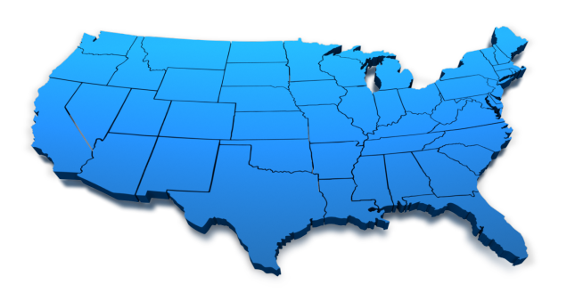
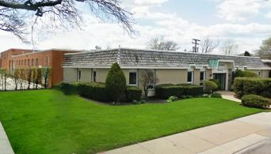
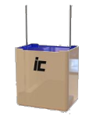
About Us
Founded in 1934
Illinois Capacitor is Privately Owned & Operated
Corporate Headquarters: Lincolnwood, IL
North American Engineering, Sales, & Warehousing

Slide 3
Brief Milestones
Founded in Chicago in 1934 by two technology-minded brothers, the Kurland’s, the firm began as the “Illinois Condenser Company.” IC grew with the Radio, TV, Automotive, and Industrial markets.
Some of the most important patents in electrolytic capacitor technology were registered by Illinois Condenser, demonstrating engineering leadership. Components were manufactured in Chicago, Illinois until 1969, when for competitive reasons, equipment and production moved to Asia and Italy. At that time, the company was renamed, Illinois Capacitor.
In 2002 a management buyout of the Kurland family occurred.
On January 30th, 2015, CDE purchased Illinois Capacitor.

Slide 4
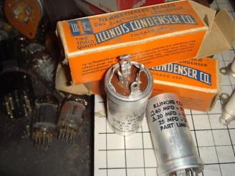
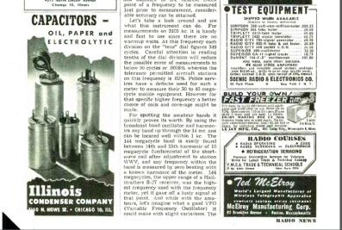
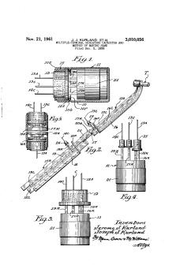
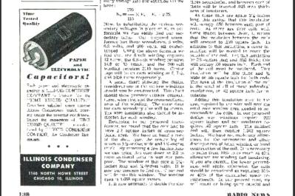
Production
Transferring technologies to Asia & Europe

Slide 5
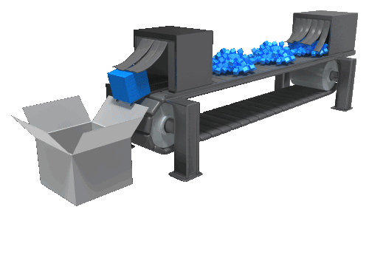
Global Manufacturing & Delivering
Notes:
Illinois Capacitor has in place global manufacturing facilities to support our customers across the globe.

Slide 6
Manufacturing Locations
China
Taiwan
India
Europe

Slide 7
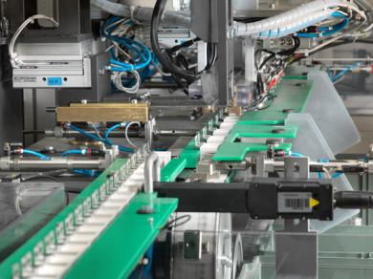
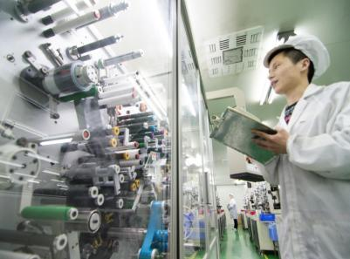
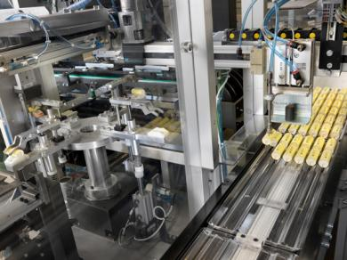
Manufacturing Capabilities
Advanced Technology & Automation

Slide 8
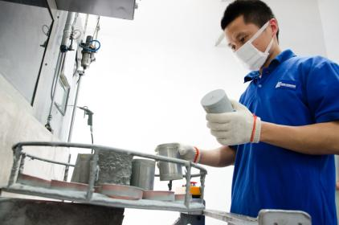
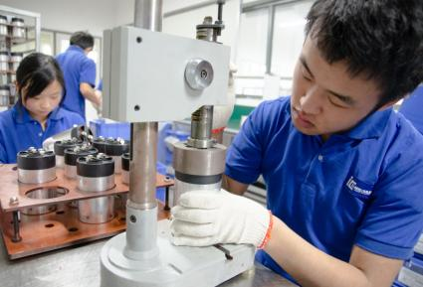
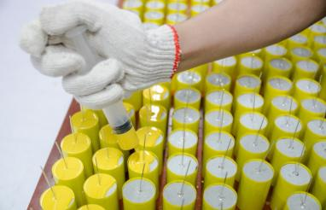
Manufacturing Capabilities
High Flexibility In Turnarounds & Customization

Slide 9
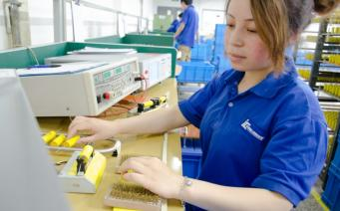
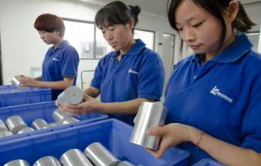
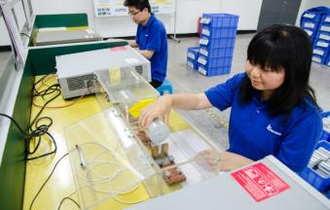
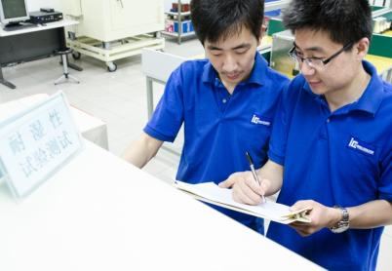
Manufacturing Capabilities
Strict Quality Control, Inspection & Assurance

Slide 10
Illinois Capacitor Sales
~ 50% of Sales goes through Distribution in N. A.
~ 25% of Sales goes through Distribution Internationally
~ 60% of Sales is in Aluminum Electrolytic Types
~ 32% of Sales is in Film Types, PP and PE
~ 8% of Sales is in Super Capacitors and Modules
~ 35-40% of all sales Globally are Custom or Semi-Custom

Slide 11
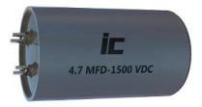
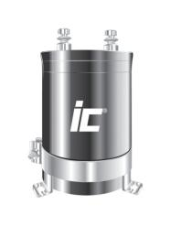
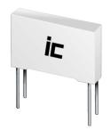
Aluminum Electrolytic Capacitor
Photoflash Capacitor
Super Capacitor
Film Capacitor
Snubber
DC Link Capacitor
Customized Capacitor

Slide 12
Illinois Capacitor Push Products
Radial Leaded Low Impedance Electrolytics
KXM, TXK, KBM, and KFM
Radial/Axial Box and Direct Mount Snubber & PP Capacitors
PPB/PPR, PPA, PMB/RMB, MHBS, PHC & PHB
Radial Box X2 for EMI Supression
MKP
Aluminum Polymer
AVG/ALG 125C, XMPL layered chip type, UVG/UVR SMD
Aluminum Photo Flash
Custom and Semi-Custom designs
FSL, FSR, FSB
EDLC Super Capacitor Single Cells and Modules
DCN
SCM

Slide 13
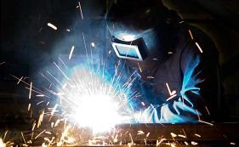
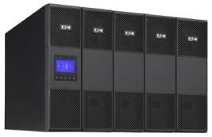
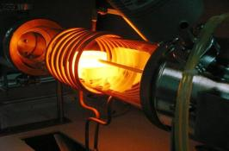
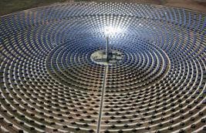
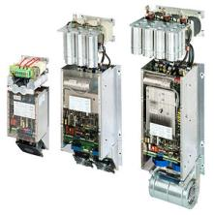
Welding
UPS-Power Supply
Induction Heating
Major Applications
Solar Power
Wind Power
Motor Control

Slide 14
Global Presence
Global Customers
Schneider Electric
Agilient
Ametek
Black & Decker
Cooper
Emerson
Fender
GE
Honeywell
Peavey
Schweitzer
Rockwell
Siemens
Tellabs
Tyco
Sharp
Foxconn
Flextronic
Sanmina
Venture
Jabil
Celestica
Sungrow
Delta
Mitsubishi Elevator
Philips Lamp
Keytronic
Larsen & Toubro
Cooktek
Johnson Controls
Secure Meters
Skinovation
Telefield
Future
Arrow
Richardson

Slide 15
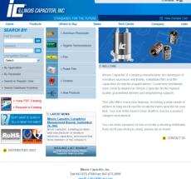
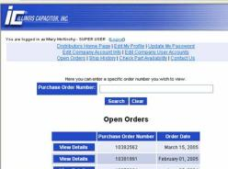
Illinois Capacitor Website
Easy to use capacitor selection tools
PDF’s of everything in our extensive catalog
Distributor Access directly from our website to check order status, P&D, etc.

Slide 16
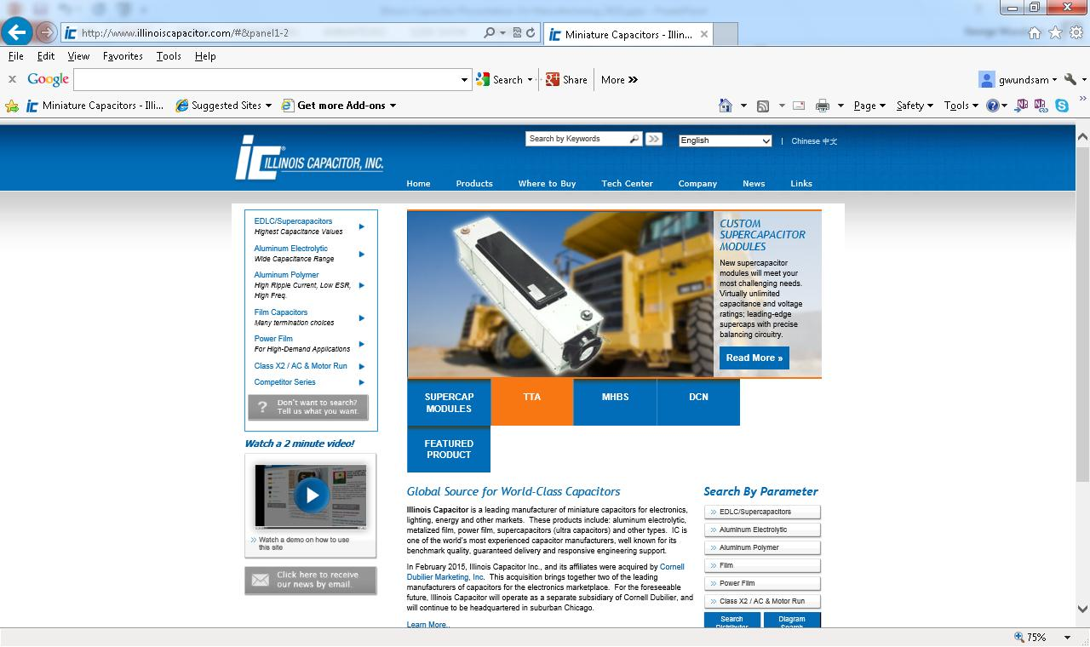

Slide 17
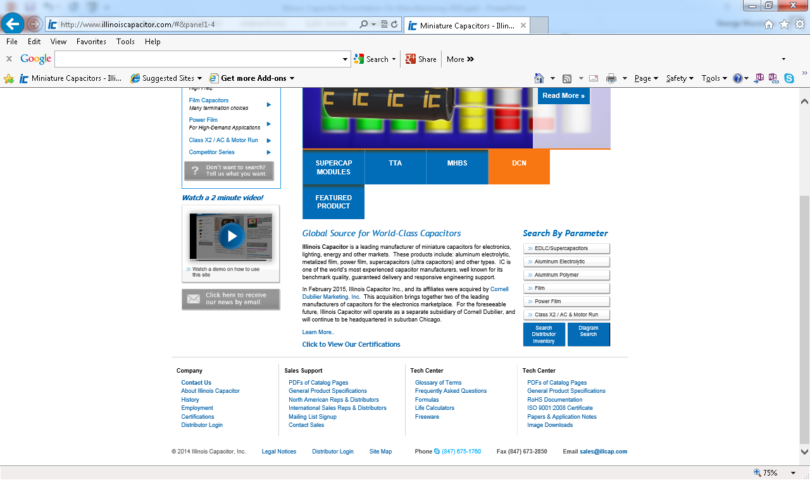

Slide 18
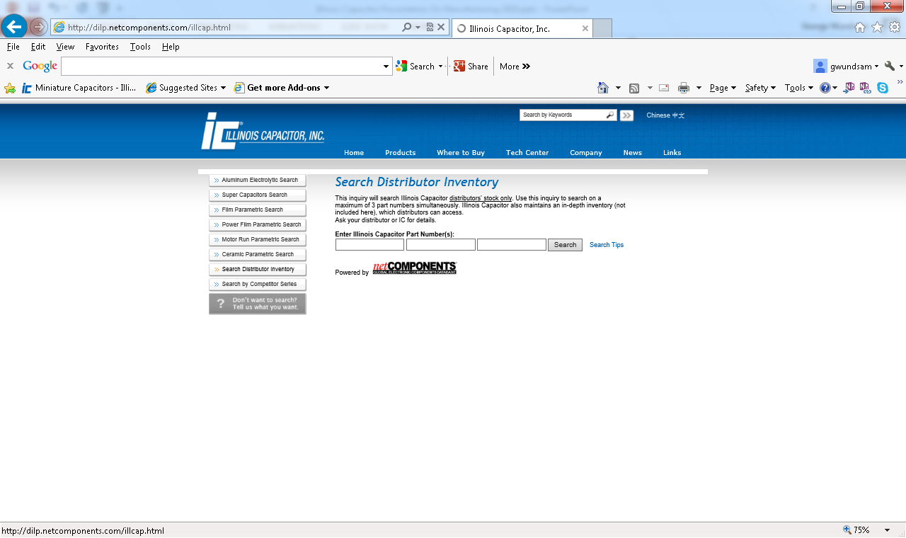

Slide 19
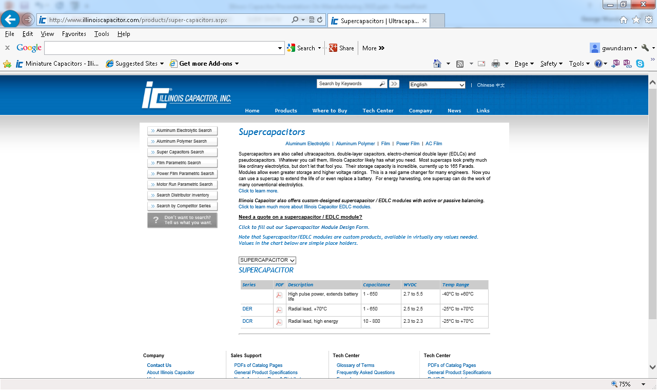

Slide 21
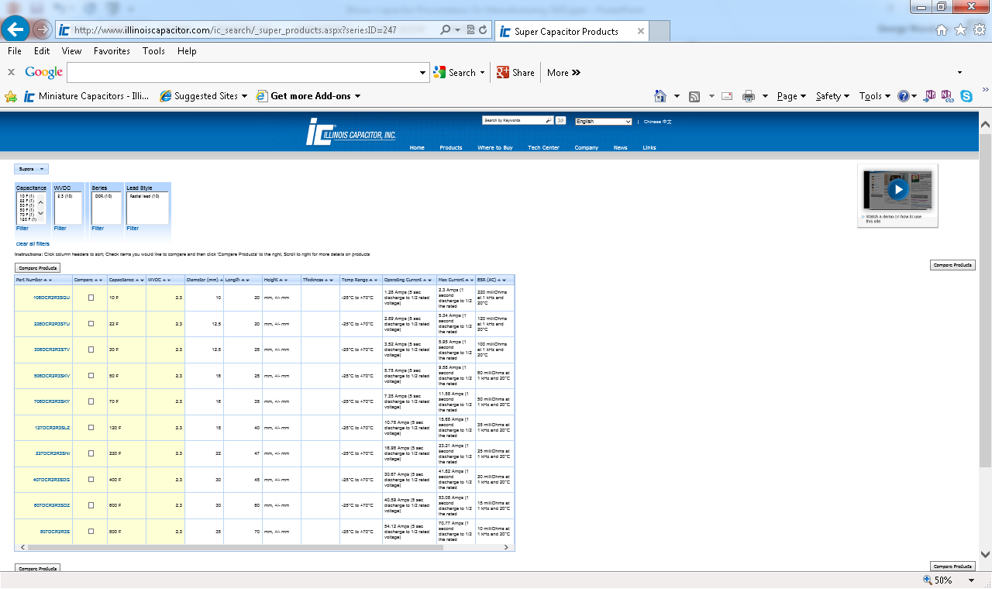

Slide 22
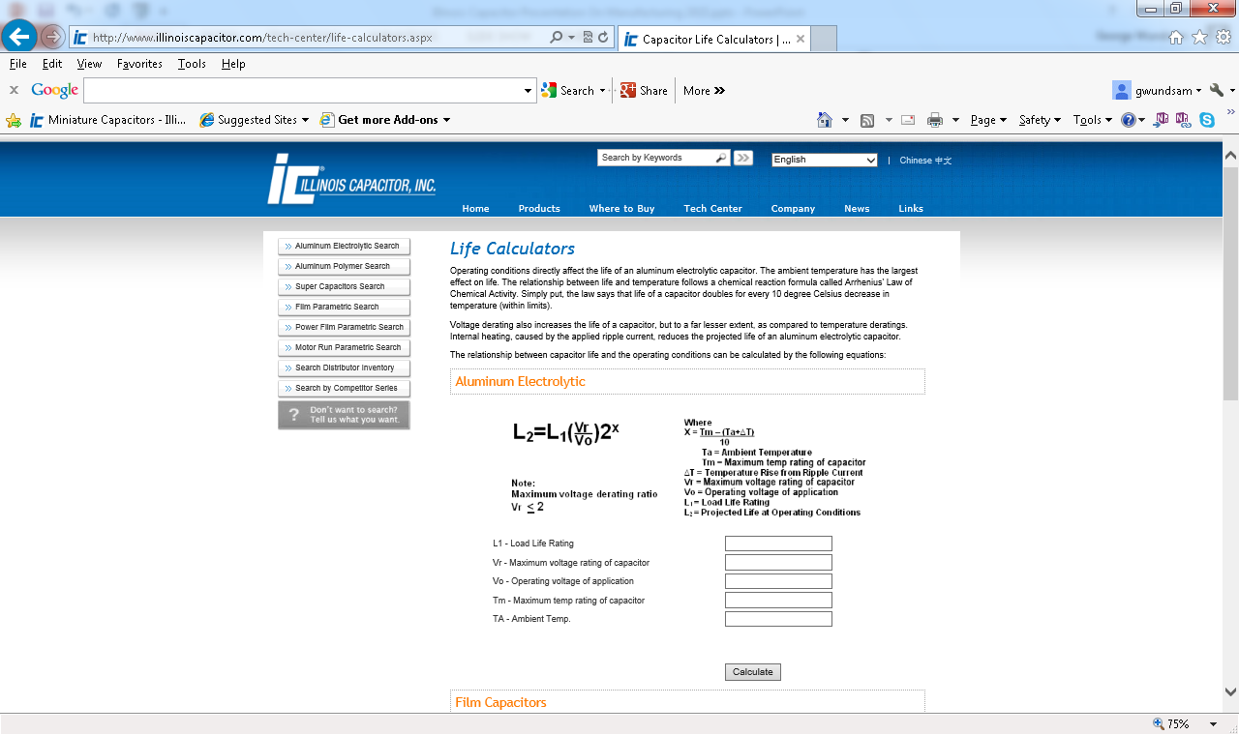

Slide 24
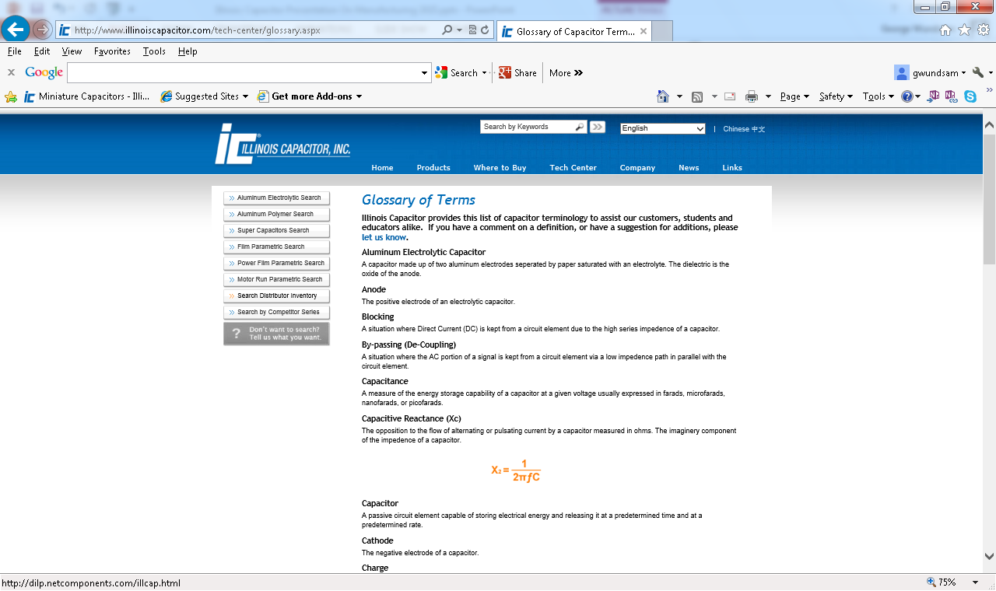

Slide 25
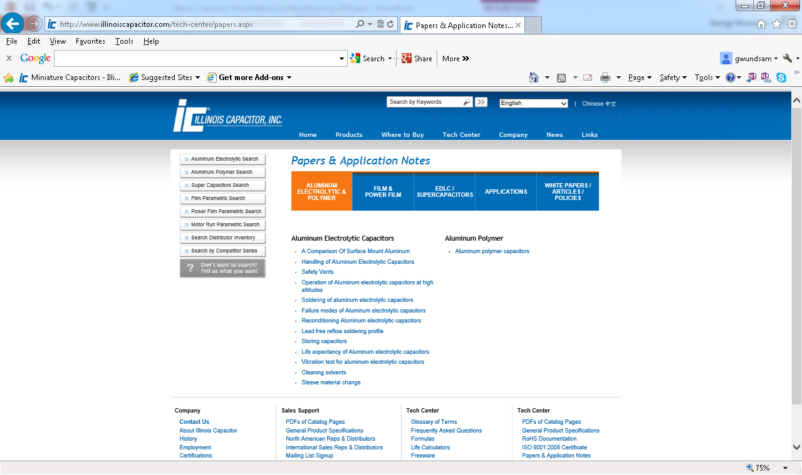

Slide 26
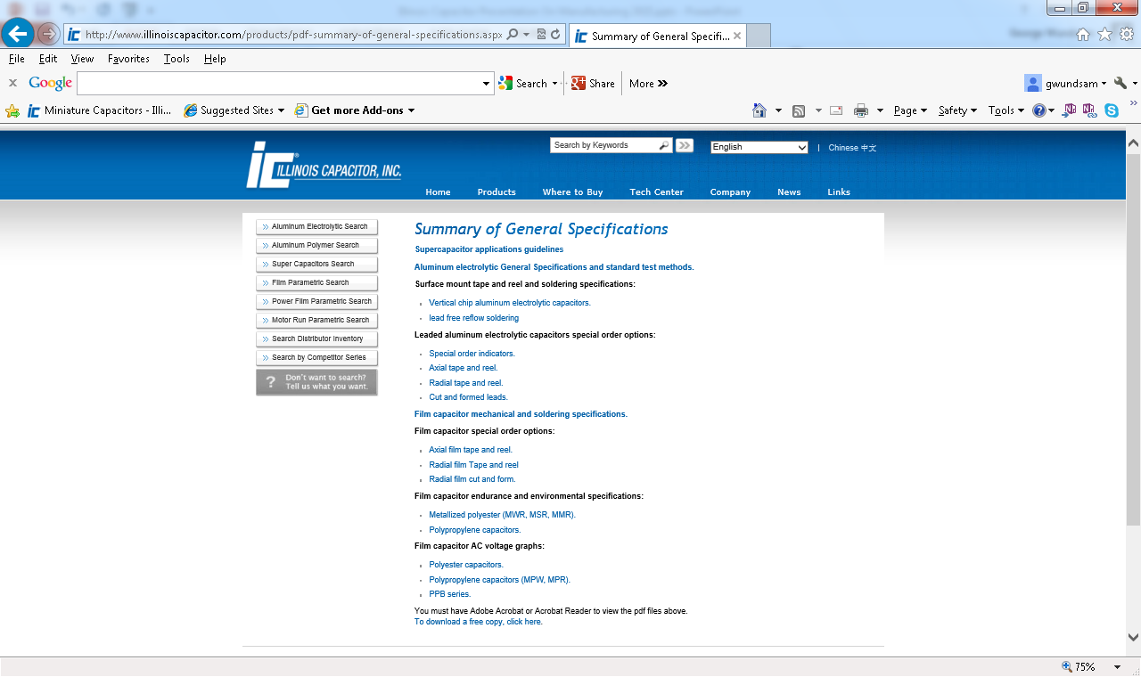

Slide 27
Summary
Illinois Capacitor has outstanding print position
Because of the customer loyalty that we enjoy
Excellent customer service and high quality coupled with competitive pricing generates loyalty
We estimate that we have approvals that are greater than 2 - 3 times our current sales level – plenty of room for growth
Illinois Capacitor maintains extensive inventory
Over 70% of our catalog is in inventory
The vast majority of orders ship from stock
Illinois Capacitor is RoHS compliant
This big change in our industry represents opportunity!
Illinois Capacitor has first in class customer service
Highly qualified and regularly trained inside staff
Distributor internet access to obtain P&D, order status, etc.
Quick turnaround on phoned in, faxed, and e-mailed RFQ’s and sample requests with a personal touch to ensure total satisfaction
2pm same day shipping

Slide 28
Questions? More Information?
Illinois Capacitor, Inc
Tel:847-675-1750 Fax: 847-673-2850
sales@illcap.com
Illinois Capacitor (HK) Ltd
Tel:852-2793-0931 Fax:852-2793-0731
sales@illcap.com.hk
www.illinoiscapacitor.com

Slide 29
Contacts at IC
George Wundsam - Vice President of Sales - Ext. 748 gwundsam@illcap.com
James Valentino – Director of Technical Sales and Support
jvalentino@illcap.com
Bill Vecchio - Regional Sales Manager - bvecchio@illcap.com
Jesus Torres – Senior Sales Account Specialist - Ext. 741 -jtorres@illcap.com
Mary McKirchy - Distributor Inside Sales Supervisor - Ext. 731 - mmckirchy@illcap.com
Mark Gebbia – Director of Engineer - Ext. 730 - mgebbia@illcap.com

