Slide 1
CDE HHT Series Axial-Leaded Aluminum Electrolytic Capacitors
175 °C, Ruggedized Design for Mission Critical Applications

Slide 2
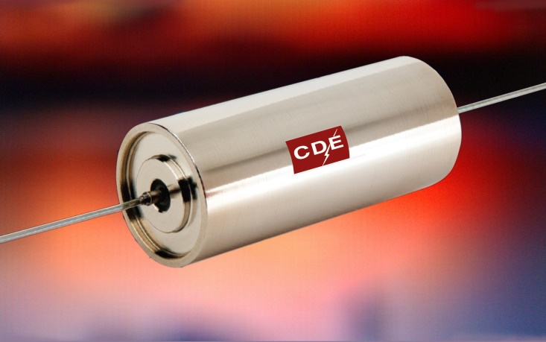
CDE HHT Series Ruggedized Axial-Leaded Aluminum Electrolytic Capacitors
The HHT is the only axial-lead electrolytic featuring a glass-to-metal seal to prevent dry-out of the capacitor electrolyte.
Rated at 175 °C, for 2,000 hours and an industry-best 5,000 hours at 150 °C with ripple current ratings up to 10 Arms
Withstands vibrations up to 20 g’s
In short, HHT capacitors go where others can’t.

Slide 3
HHT Series includes nine values, with a focus on popular ratings.
Capacitance from 470 µF to 4,700 µF, with voltage ratings from 16 Vdc to 40 Vdc.

Slide 4
Built to take the heat and shake off the g forces.
Key characteristics make the HHT an excellent match for high-stress applications in military, aerospace, down-hole and off-road transportation.
20g vibration rating (MIL-STD-202, test method 204)
175 °C performance, usually requiring considerably more expensive wet tantalum technology

Slide 5
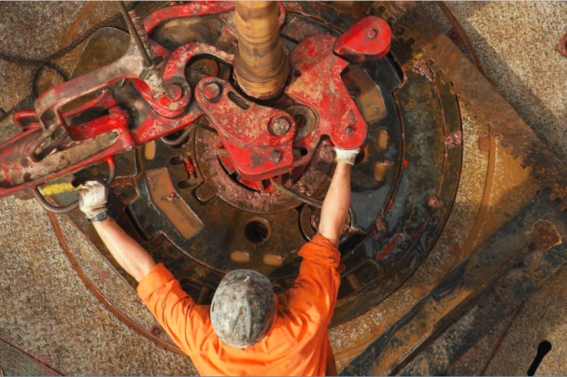
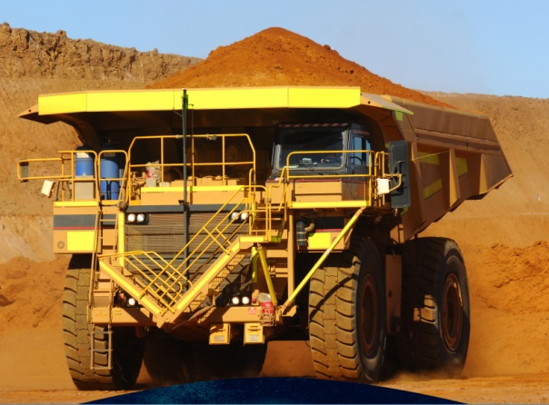
Performance for the long run.
Glass-to-metal seal maintains capacitance and ESR values over end-product lifespan
10 year shelf life @40 °C

Slide 6
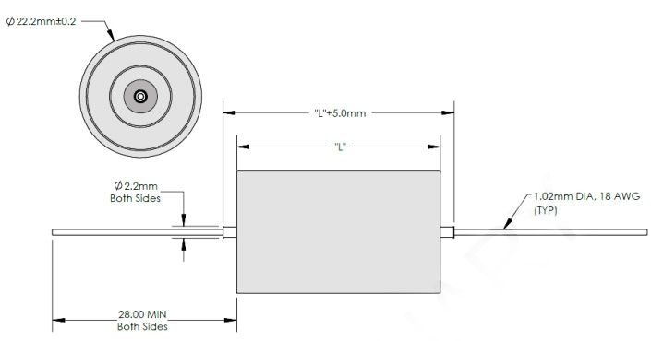
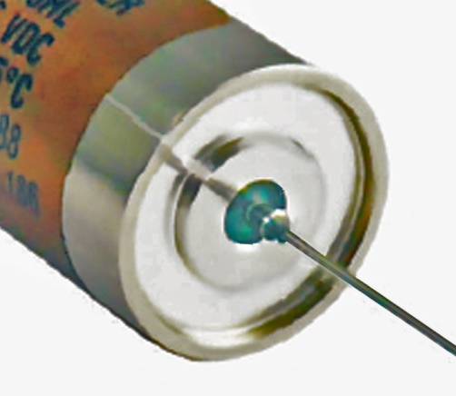
Design Characteristics
Stainless steel case
Diameter is a low-profile 22 mm for all values, with length varying from 37 to 53 mm depending on values
Patented glass-to-metal seal
18 AWG wire leads

Slide 7
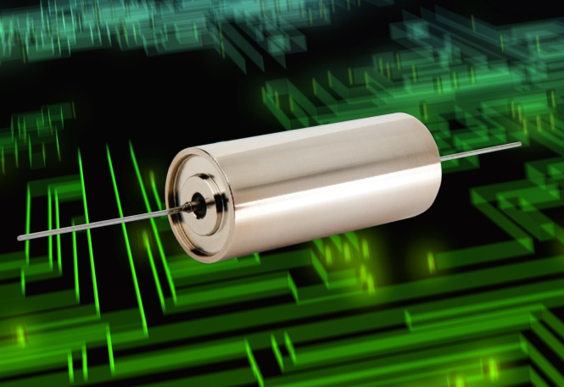
CDE HHT Series Summary
Rated at 175 °C, for 2,000 hours; 5,000 hours at 150 °C
Glass-to-metal seal prevents electrolyte dry out for long life
Up to 10 Arms ripple current @ 150 °C
Handles vibrations up to 20g’s
10 year shelf life
Nine values from 470 µF to 4,700 µF; 16 Vdc to 40 Vdc

